Slide 1
Web Application for College Placements
Developed By
YODA Super Kings

Slide 2

Agenda
Overview
Brainstorming objectives
Technologies Used
Team members
Flow chart for the Application
Summarize of the workflow with the developed screens

Slide 3

Overview
Developed the College Placement Web Application for Colleges and Companies to register for the placements
Companies can send the placement request to college with the required details for the students
Interview schedule for the eligible candidates and capturing the status of the interview for each rounds
Release offer letter to students to the Registered mail and the record of selected students with offer letter sent to the college Admin
The College placement Admin maintains the student record and the offer letters of the placed students in Admin login received from the companies
Communication and support for the college to companies regarding the record of placement date against each request

Slide 4

Brainstorming Objectives
Colleges looking for single platform for handling the placement activities.
Companies looking for single platform where they can reach out to multiple colleges and handle placement operations.

Slide 5

Technology Used
React Js
MongoDB 6.0.4
API core
Node.js v18.13.0
VS Code v1.74.3
Dot Net-SDK 3.1.426
Visual Studio v16.11.33214

Slide 6

Our Team
Chiranjeevi Lokeshwaren
Muthukumar Balakrishnan
Suriya Velayutham
Raja Shanmugavaigundaraman
Megala Kabali

Slide 7
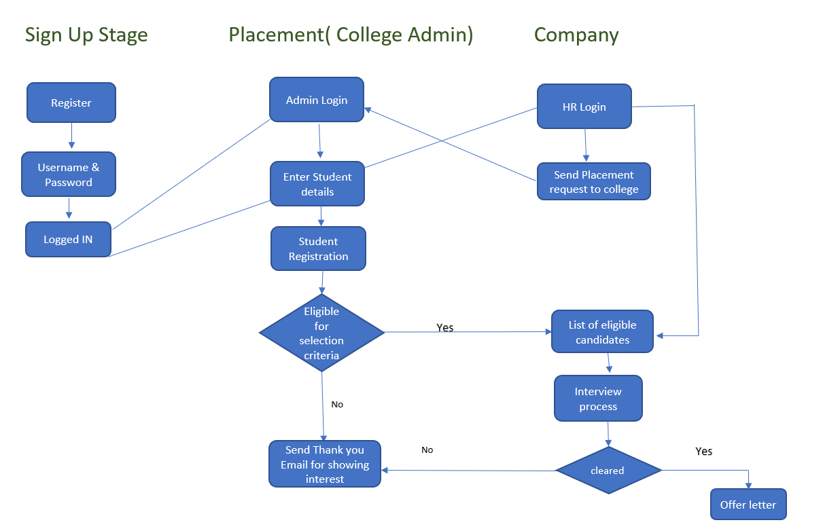

Flow chart

Slide 8

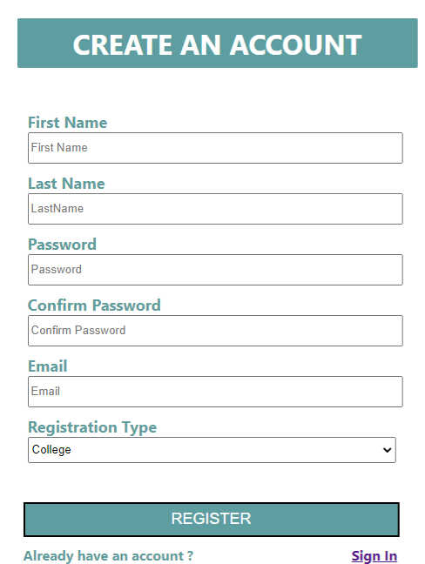
Workflow Registration Form

Slide 9
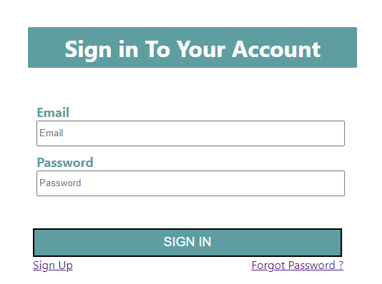

Login Form

Slide 10
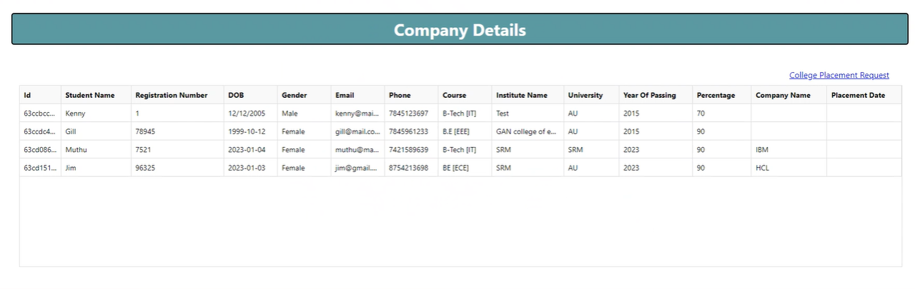
Company Dashboard

Slide 11
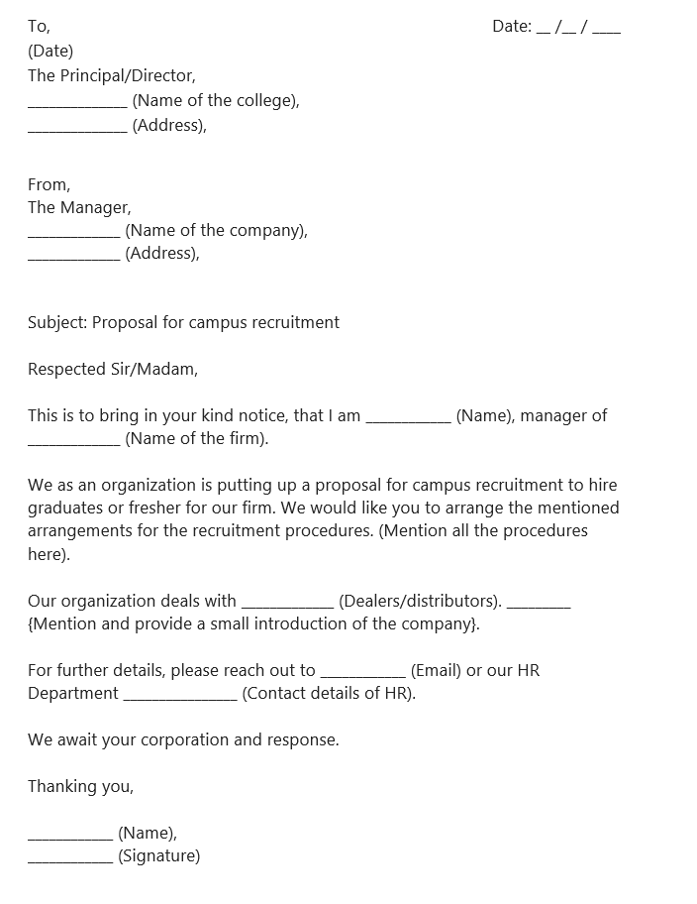
Placement Request to College

Slide 12
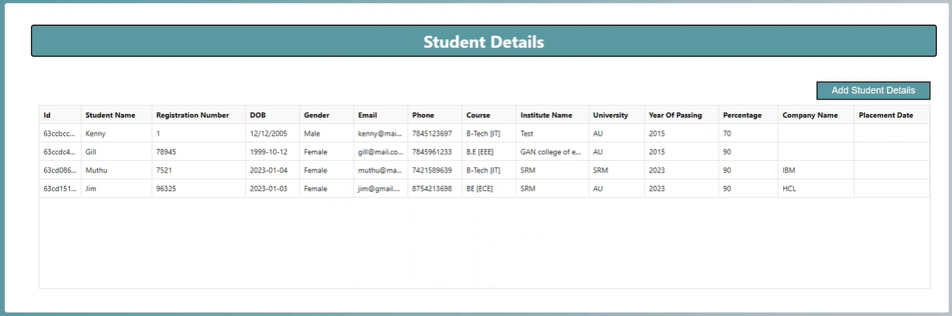
College Admin Login and Record Maintenance

Slide 13
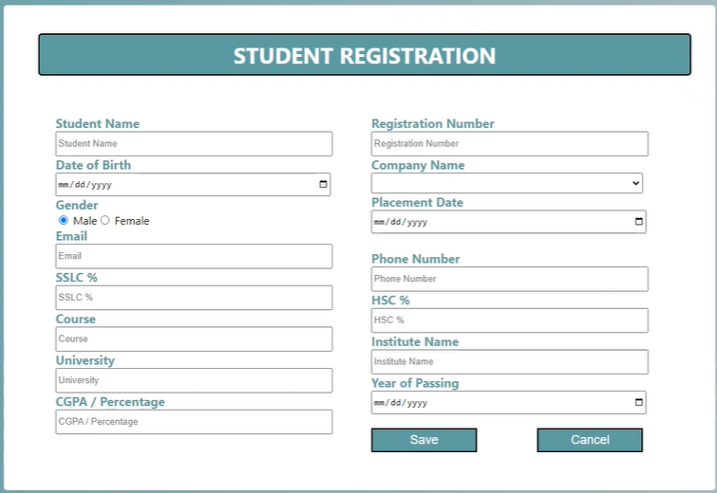
Student Registration Form

Slide 14
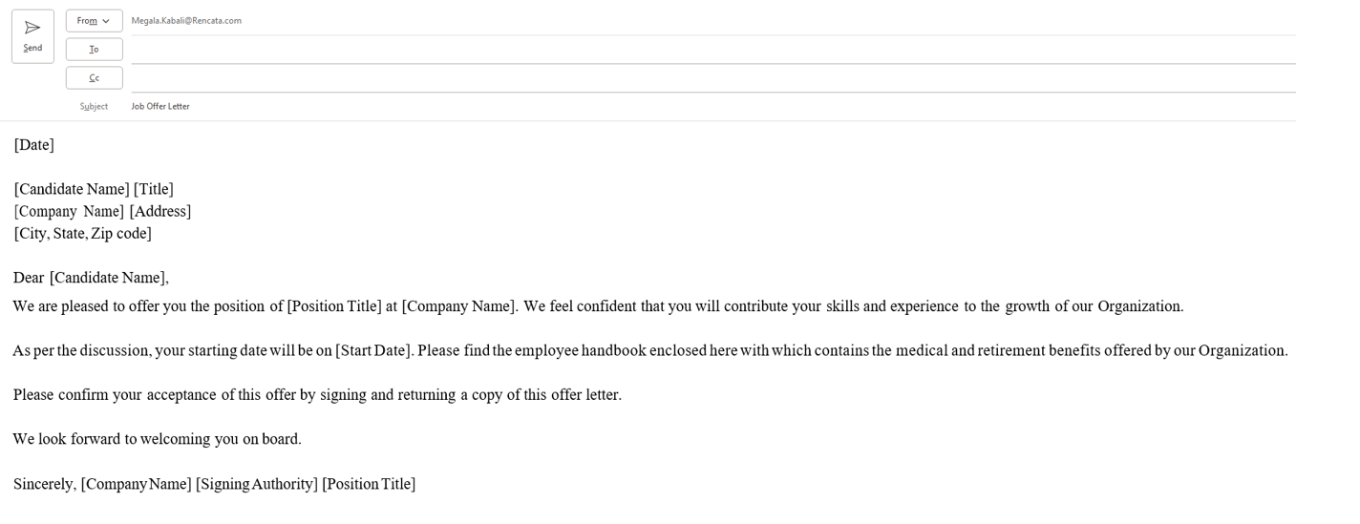
Email Template for the Placed Students

Slide 15
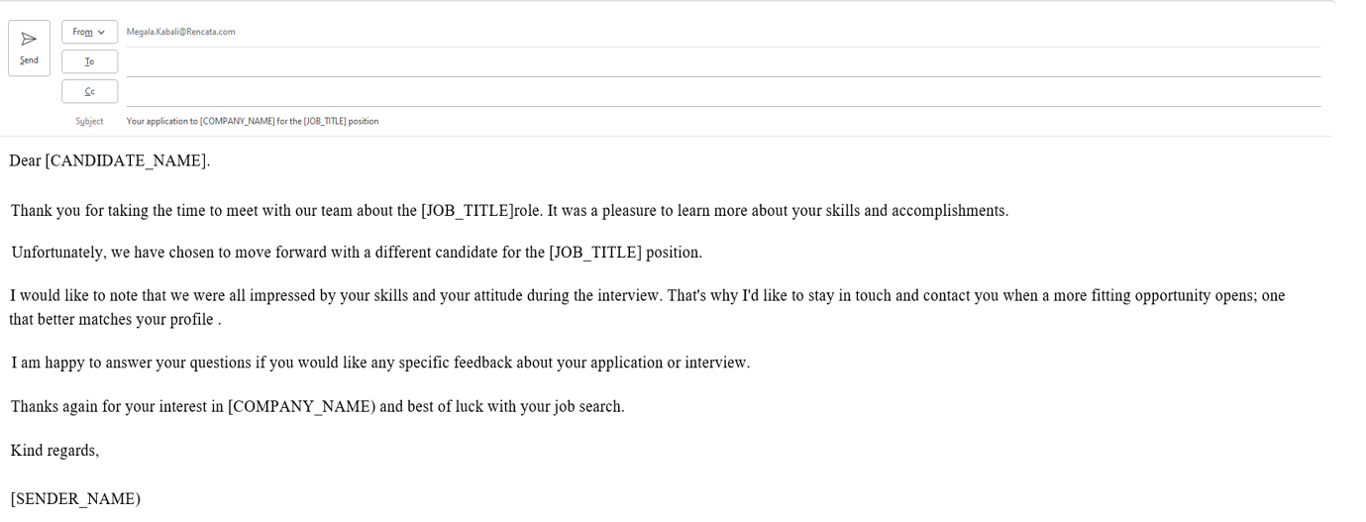
Email Template for the Rejected Students

Slide 16
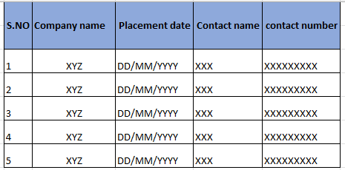

Communication of company’s Placement Dates

Slide 17

Thank you!

